Slide 1

Airline Reservation App
Saad Bin Khalid
M. Moaaz Bin Sajjad

Slide 2
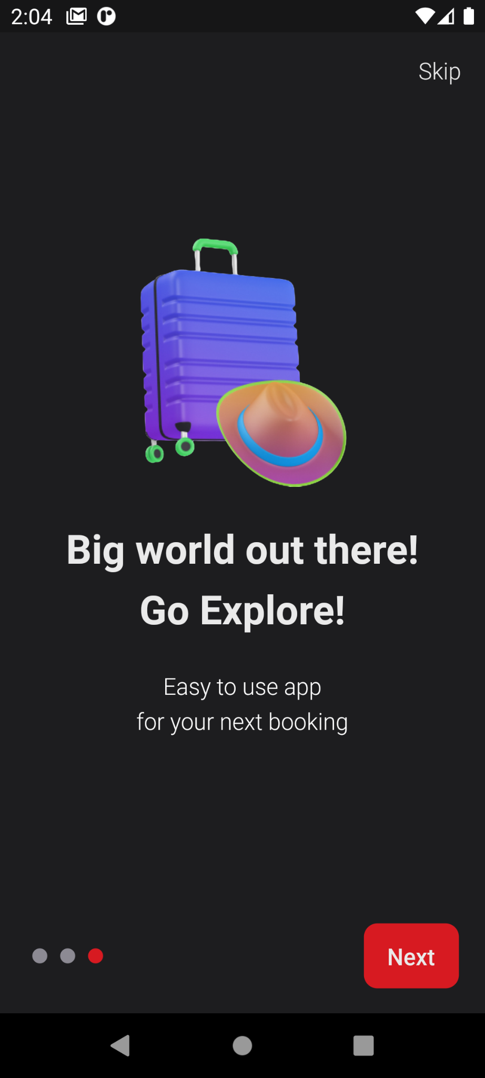
Essential Features
1. Authentication
2. Search and filter flights
3. Reserve and Cancel seats
4. Payment with credit card
5. Ticket generation in pdf format
6. Notifications before flights

Slide 3
Authentication

Slide 4
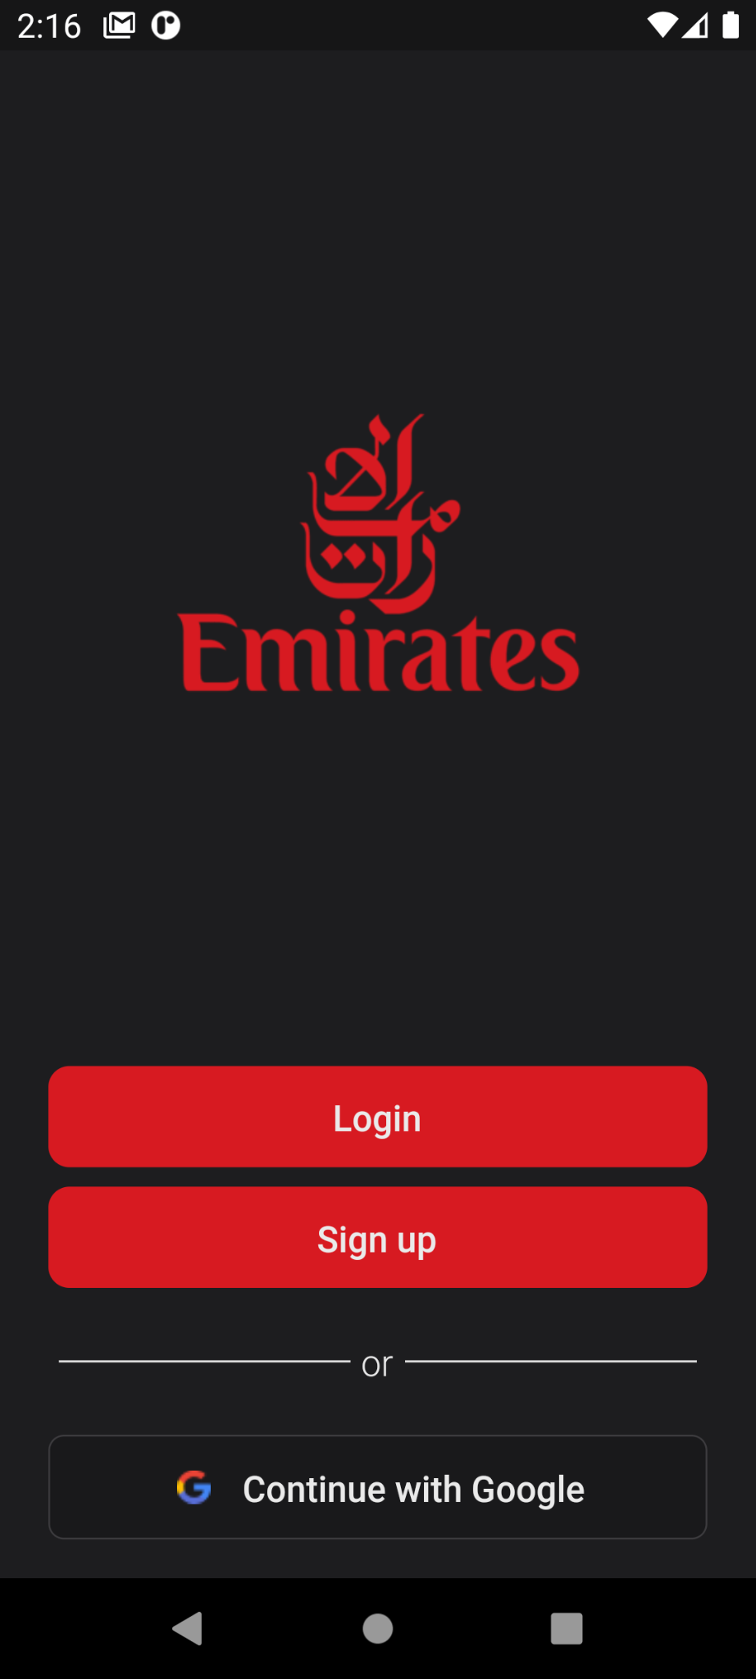
Authentication Page
1. Login
2. Register
3. Continue with social logins

Slide 5
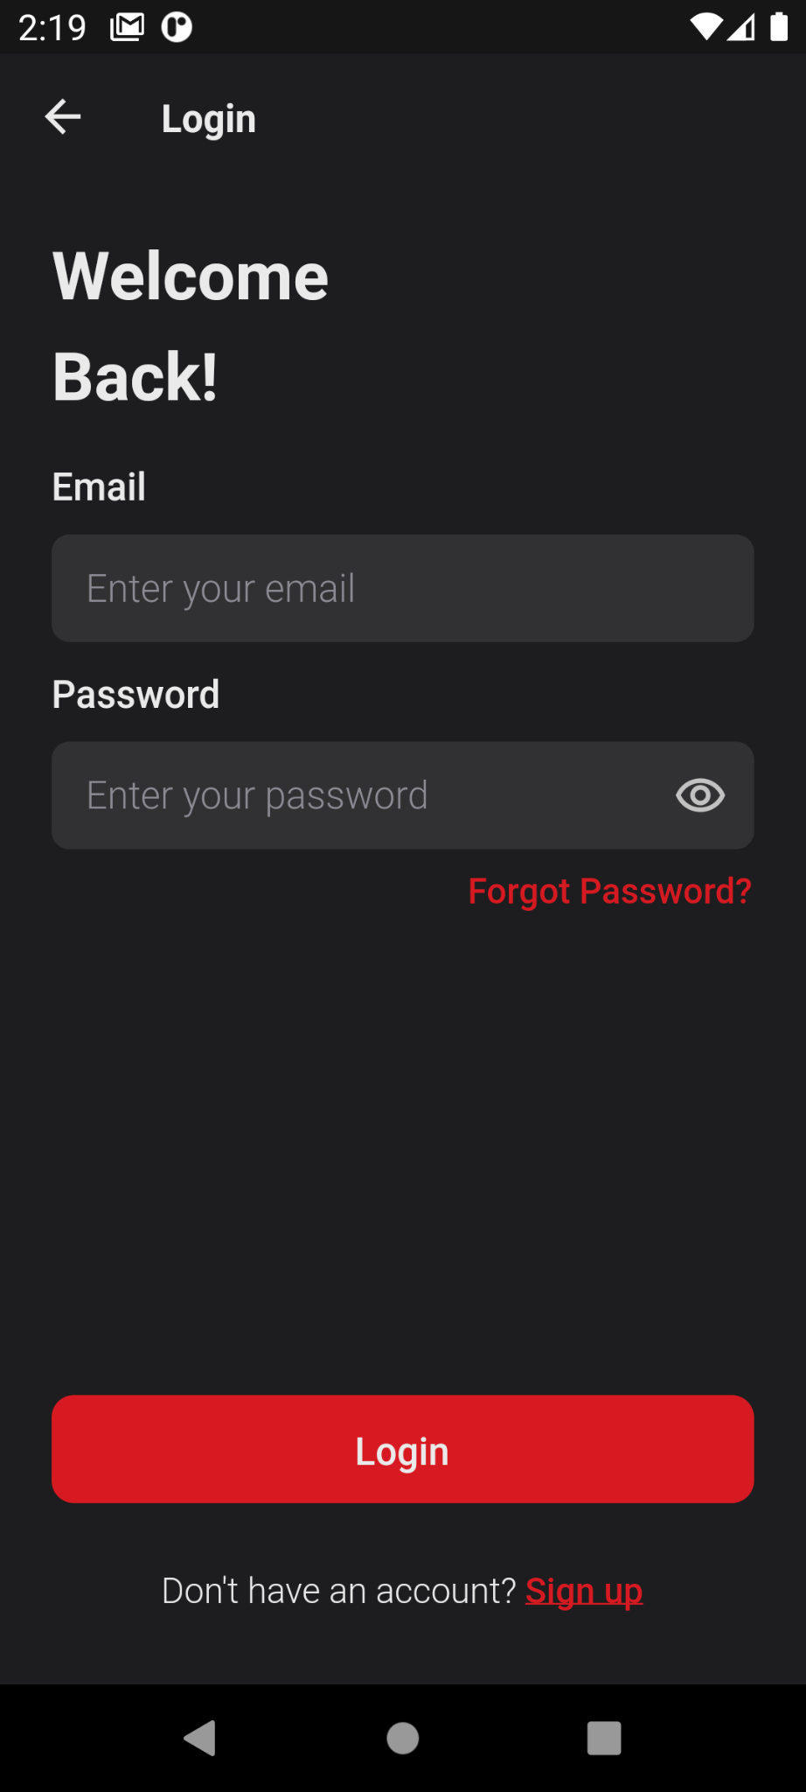
Login Page
1. Email
2. Password
3. Switch to Register screen
4. Error handling

Slide 6
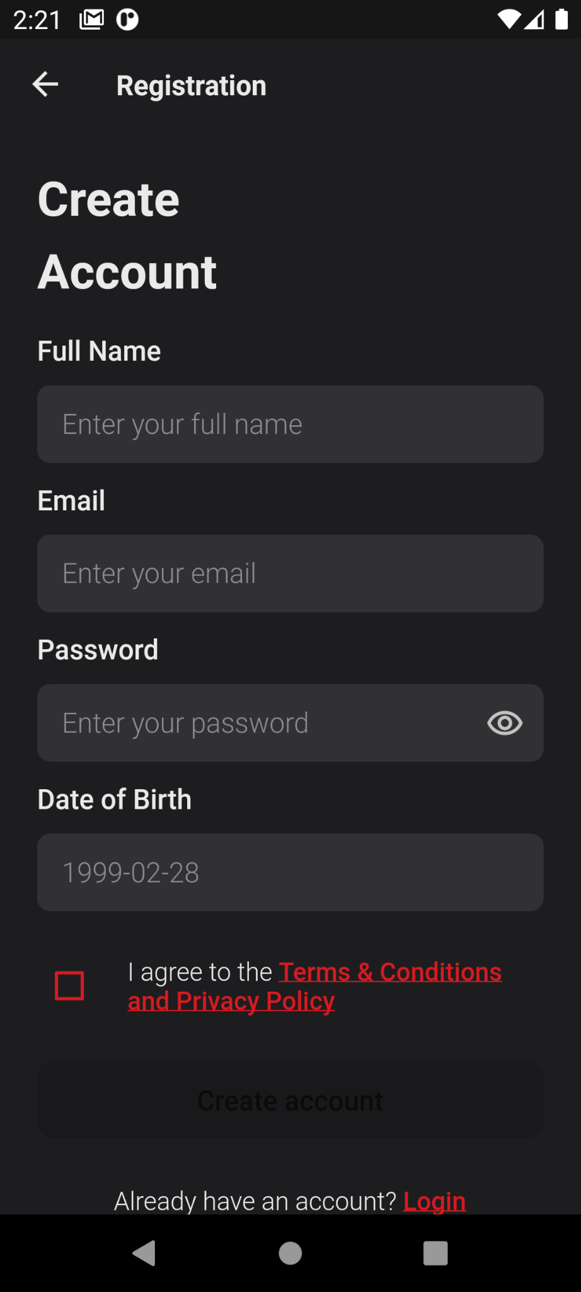
Register Page
1. Full name
2. Email
3. Password
4. Date of Birth or age
5. Switch back to login screen
6. Error handling

Slide 7
Home

Slide 8
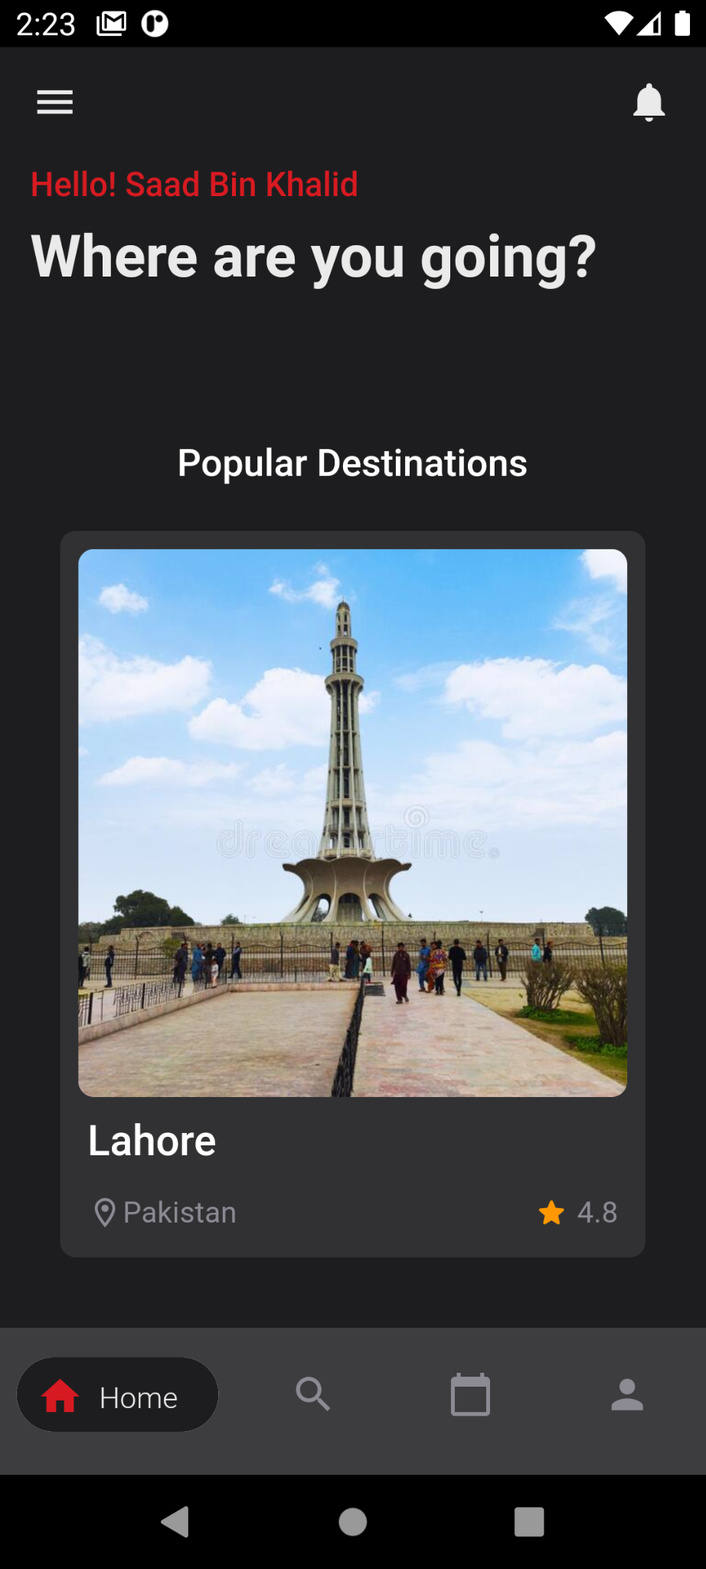
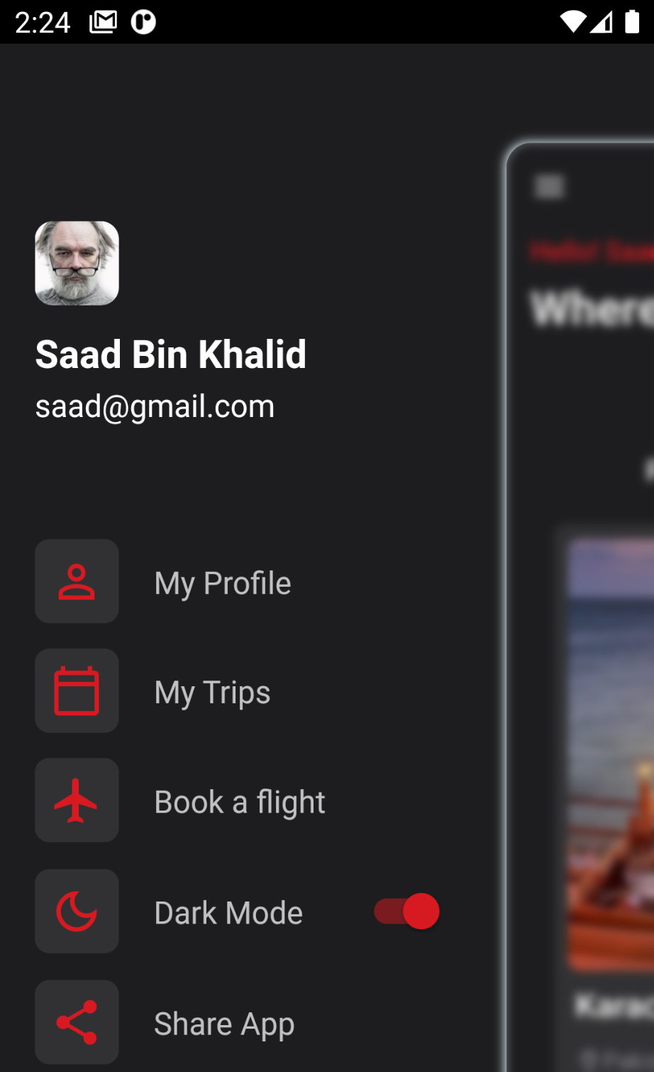
Welcome Screen
1. Popular Destinations
2. Notifications
3. App drawer

Slide 9
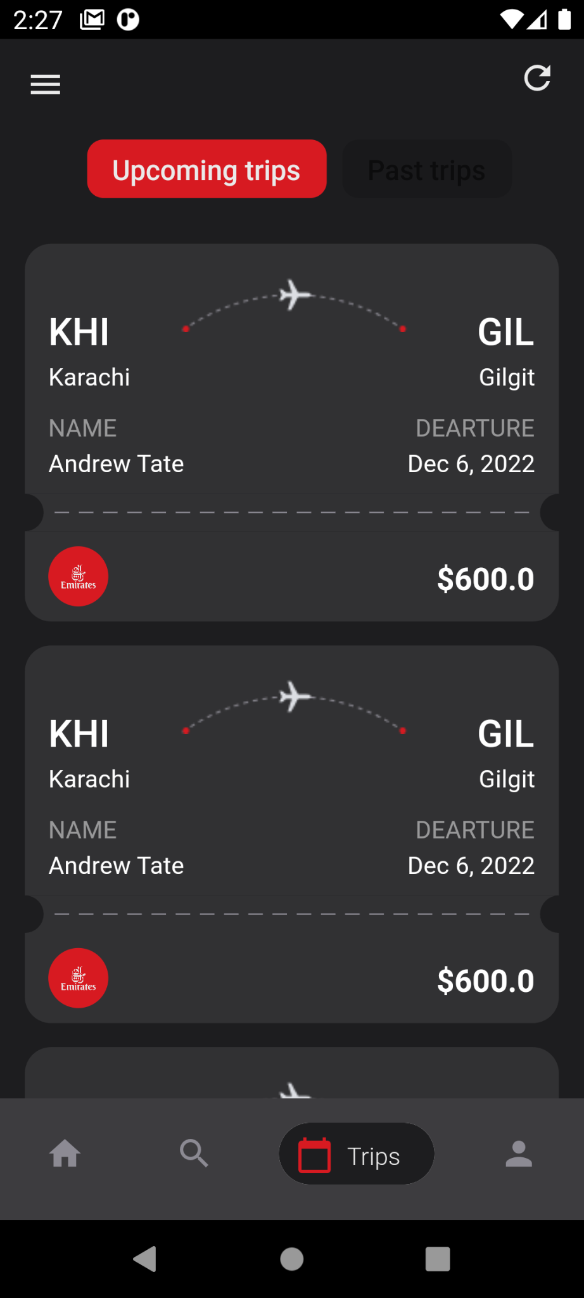
Trips Screen
1. Upcoming & History
2. Refresh button
3. Tickets summary
4. Open for detail

Slide 10
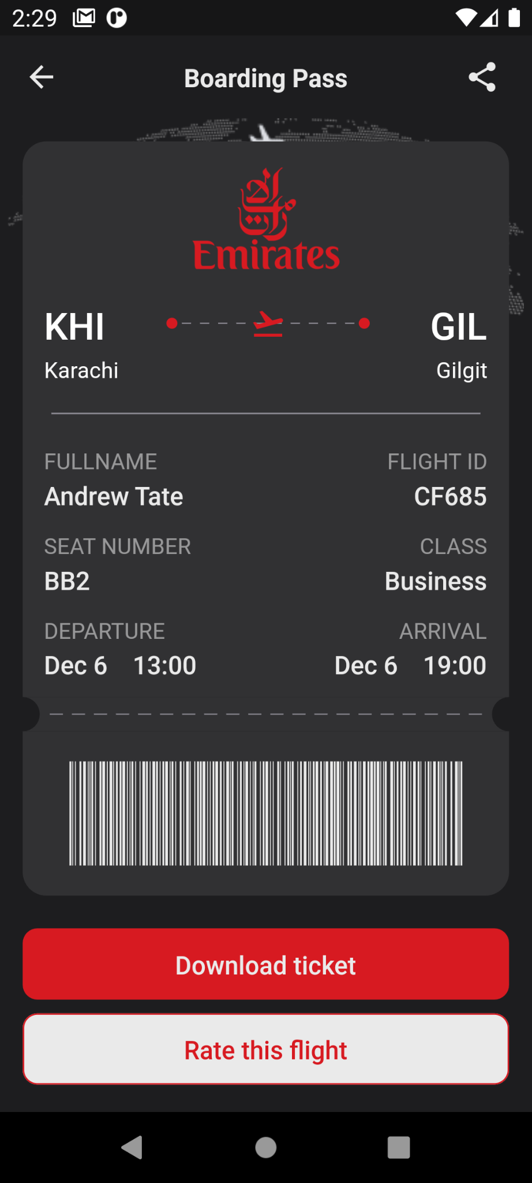
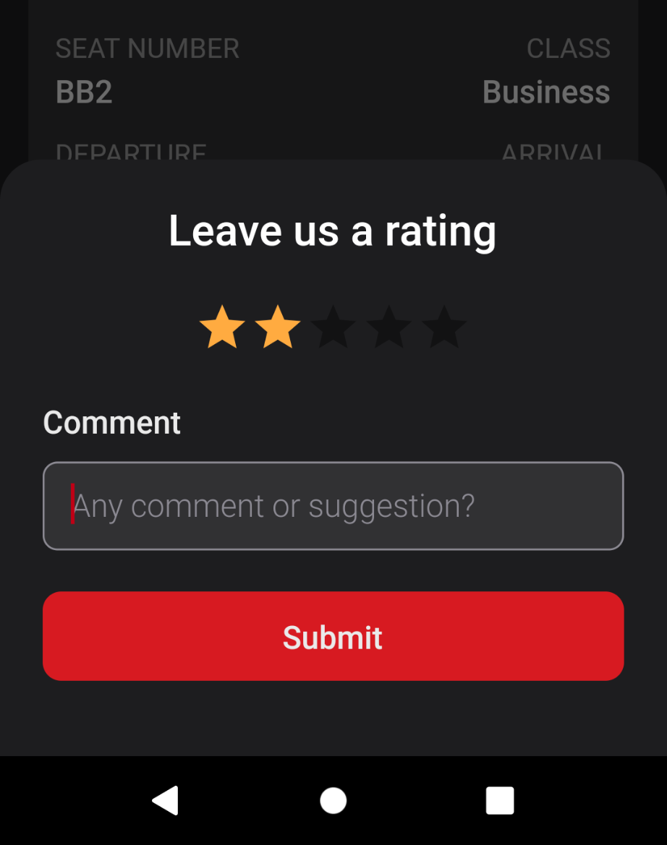
Ticket detail
1. Share button
2. Download pdf
3. Barcode
4. Record feedback

Slide 11
Flight Booking

Slide 12
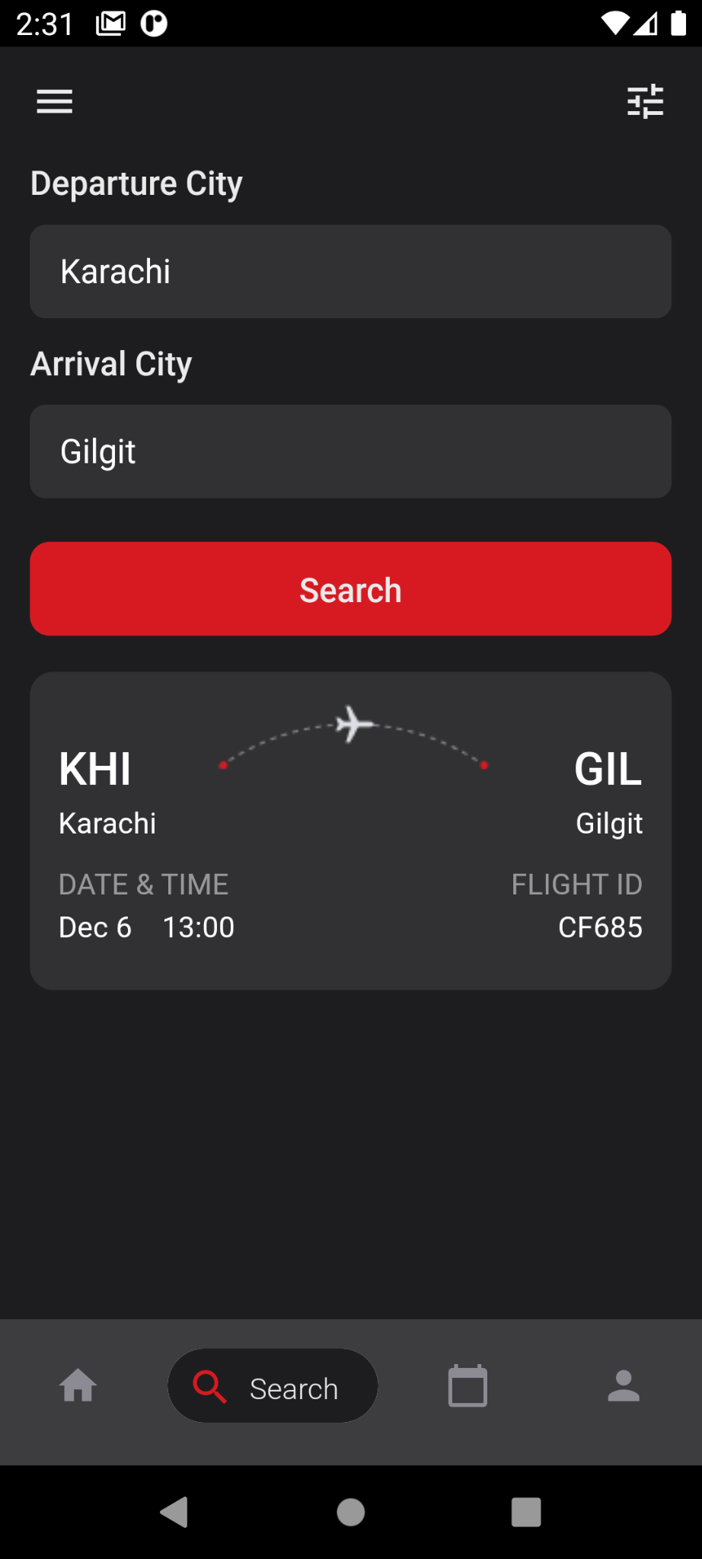
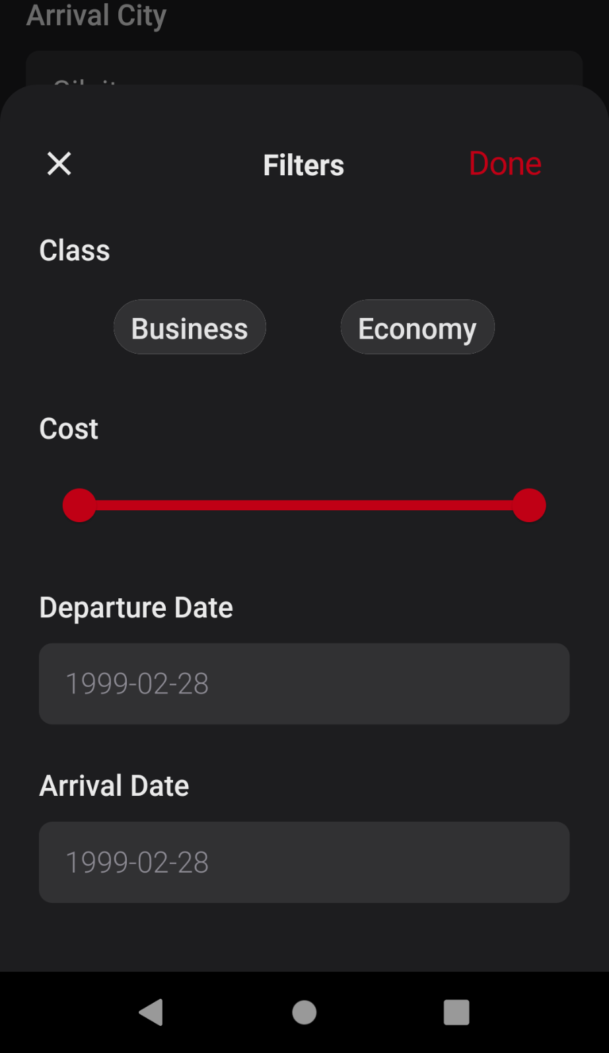
Search Flights
1. Between cities
2. Autocompletion
3. Filter Results

Slide 13
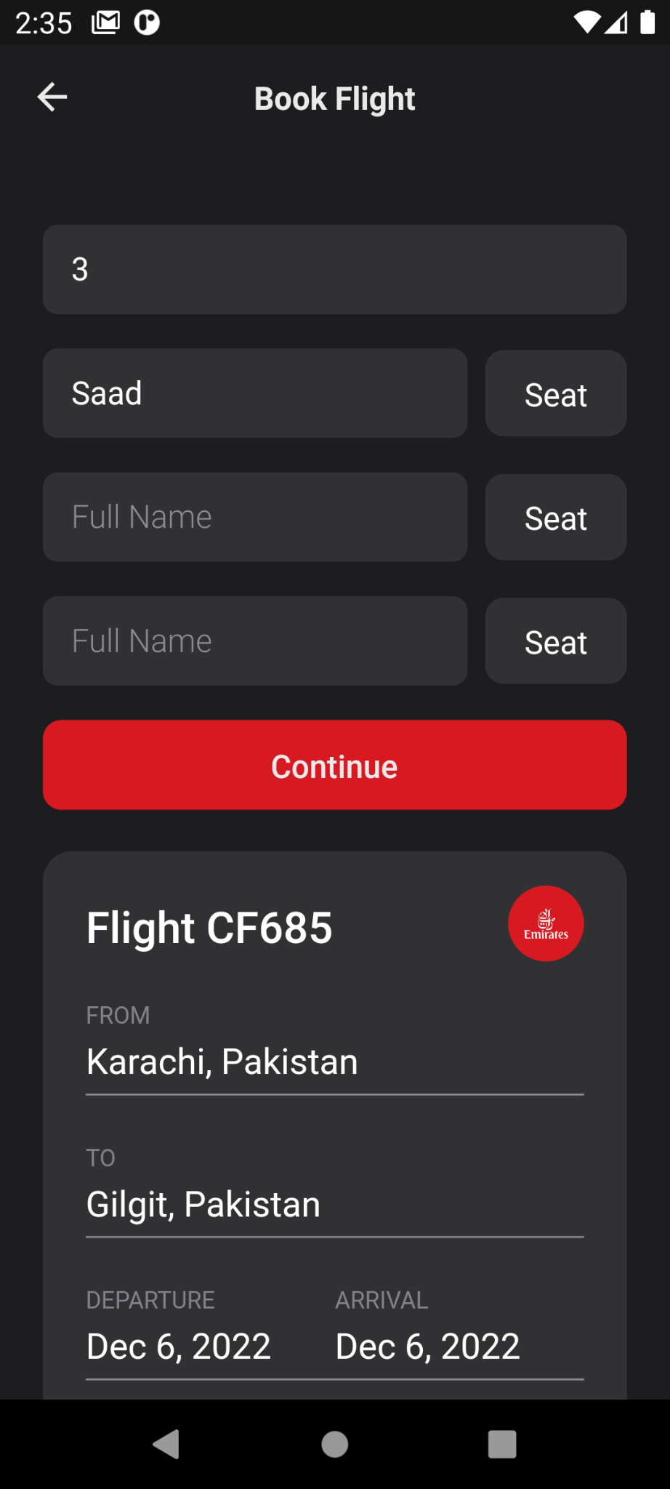
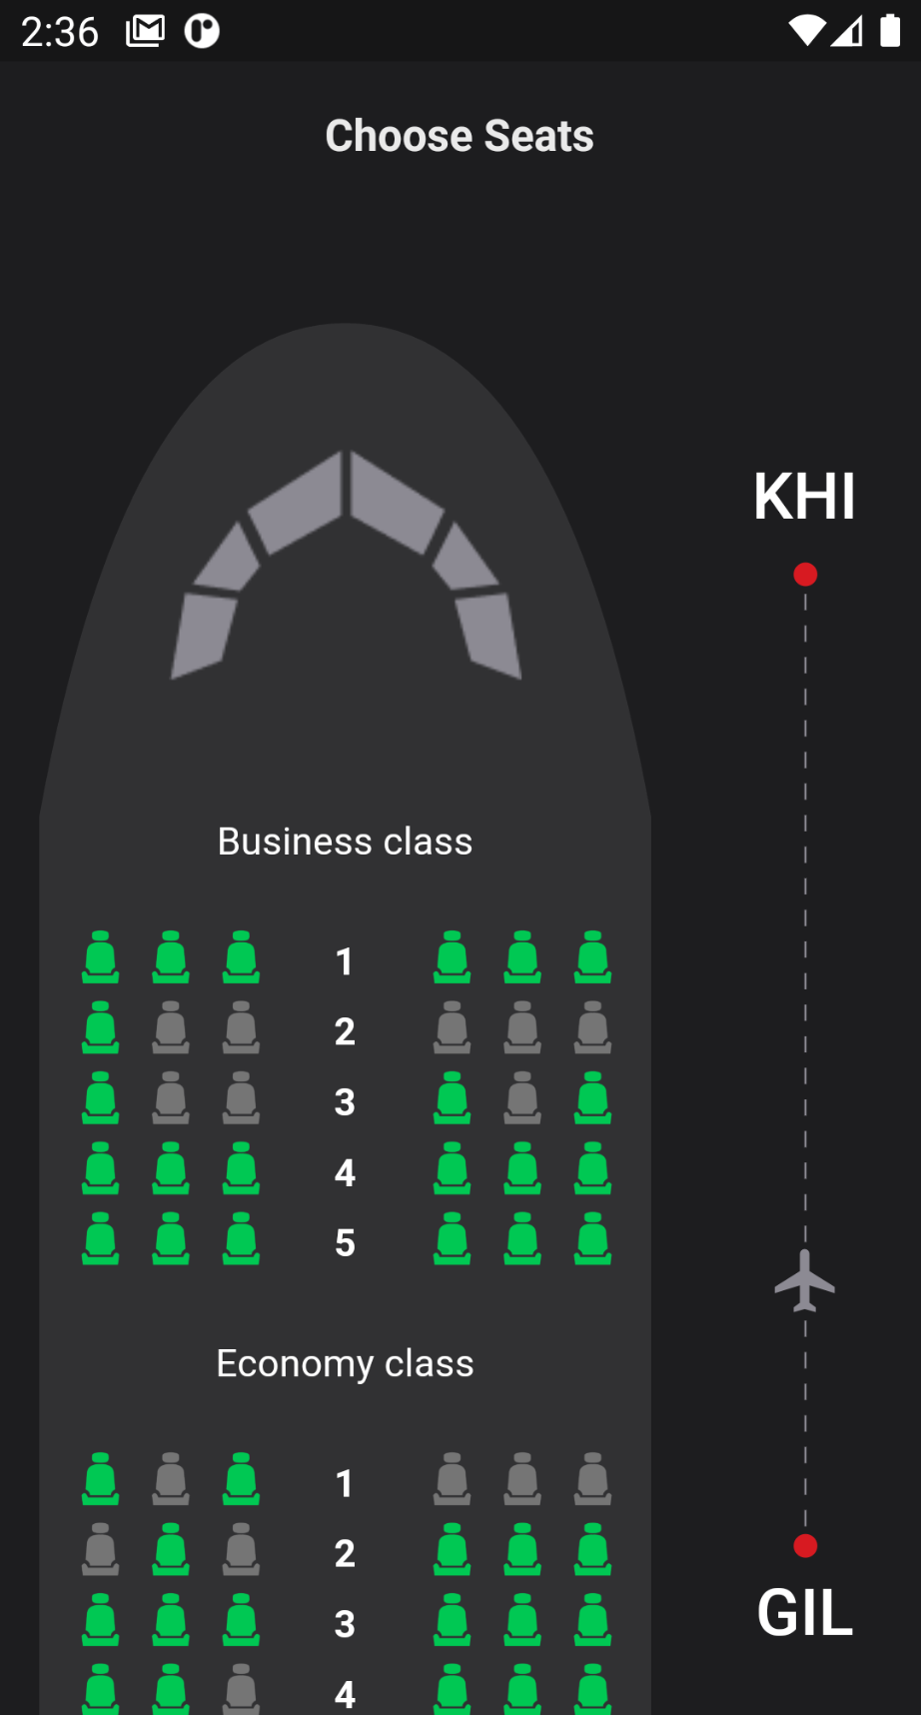
Reserve seats
1. Upto 10 people together
2. Select available seats
3. Realtime updates
4. Go back to cancel seats

Slide 14
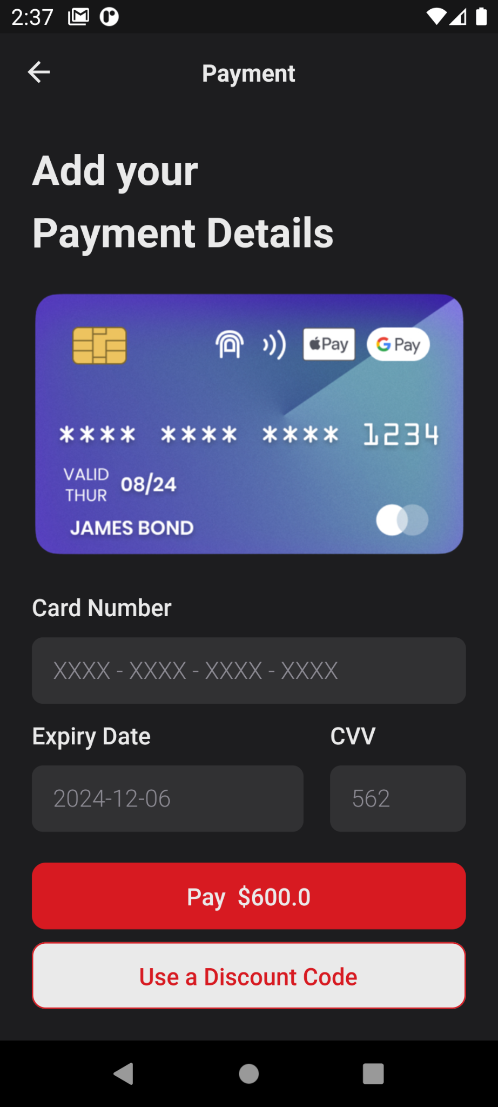
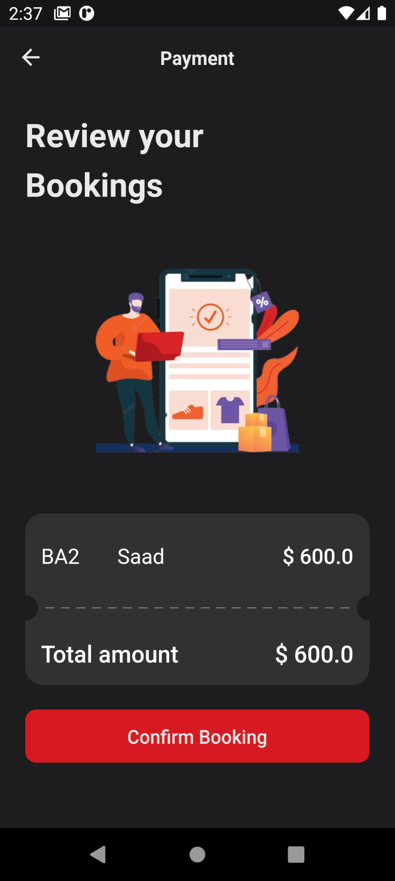
Review and Pay
1. Summary and total of order
2. Add credit card
3. Use a discount coupon
4. Seats are confirmed now

Slide 15
Review and Pay
1. Summary and total of order
2. Add credit card
3. Use a discount coupon
4. Seats are confirmed now
5. Tick detail screen again

Slide 16
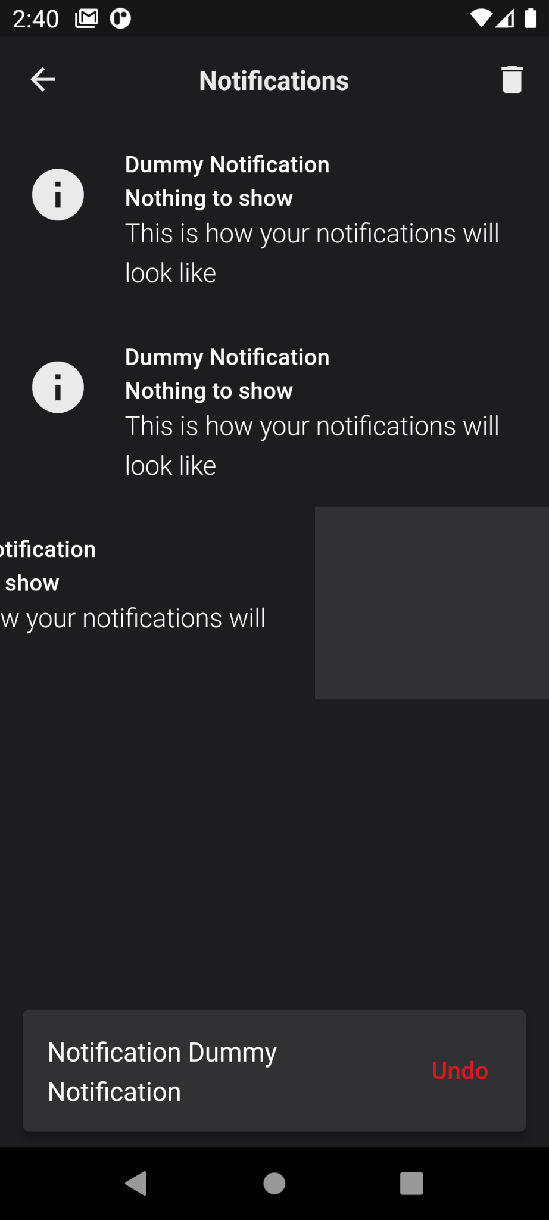
Get reminders
1. Reminder before 3 hours
2. Swipe to dismiss
3. Real notifications
4. Clear all

